Slide 1
Activity 8 – support material
Powerpoint by Helen Yip

Slide 2
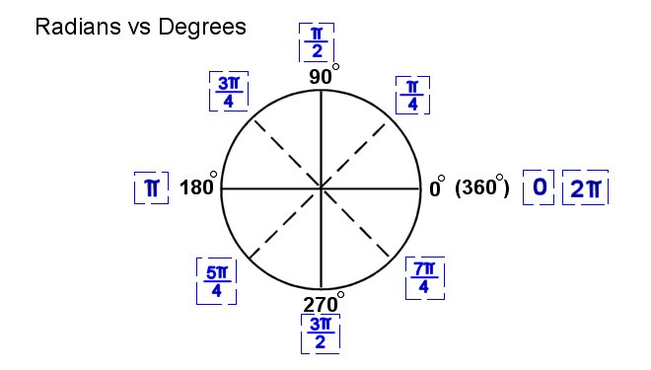
Continuing Coding Activity 8

Slide 3
Continuing Coding Activity 8
DEMONSTRATION

Slide 4
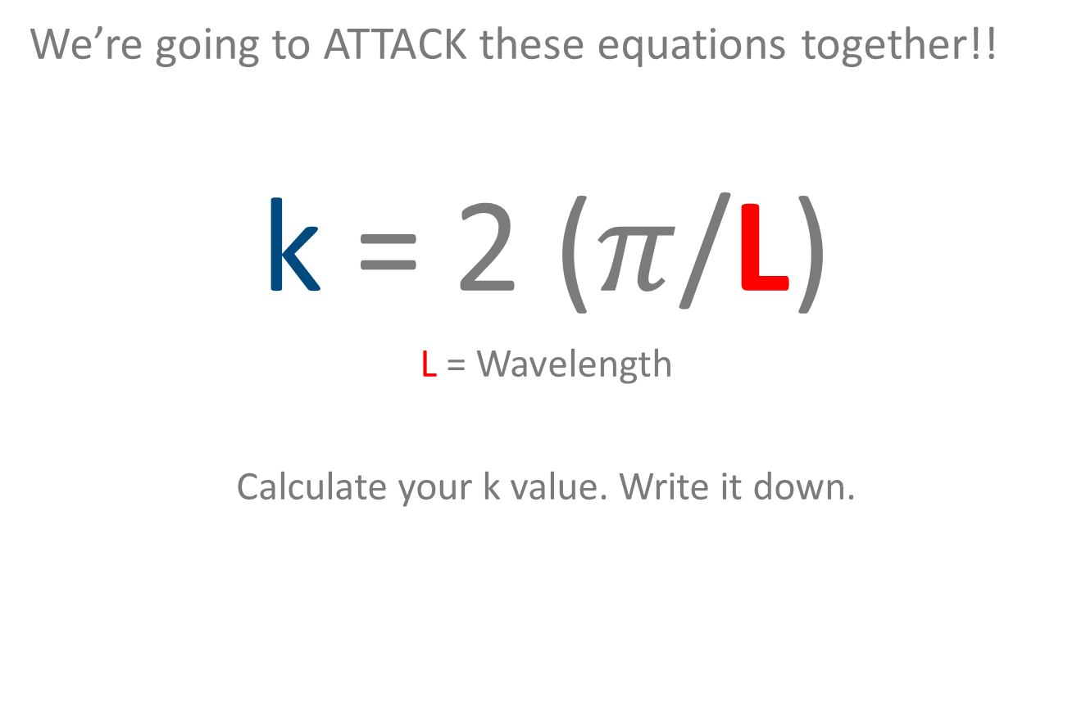
Continuing Coding Activity 8
We’re going to ATTACK these equations together!!
k = 2 ($π$/L)
L = Wavelength
Calculate your k value. Write it down.

Slide 5
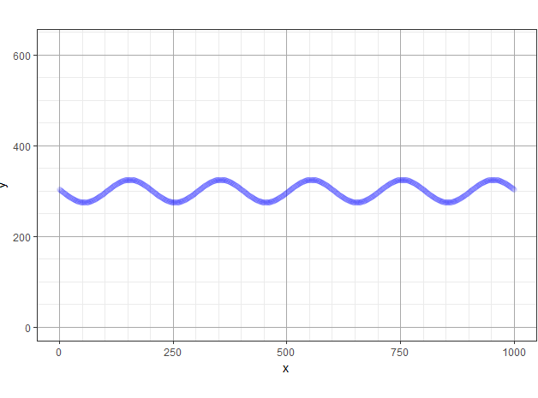
Continuing Coding Activity 8
y = A * sin(k * x + p) + H
y= y -coordinate
A = Amplitude
k = constant
x = x-coordinate
p = phase shift
H = water depth
Notes:
Talk about each data point consists of an x and y. If we know the x we want to solve for, then we need to solve for y. This complicated equation is the one that mathmeticians

Slide 6
Continuing Coding Activity 8
y = A * sin(k * x + p) + H
y= y -coodinate
A = Amplitude
k = constant
x = x-coordinate
p = phase shift
H = water depth
Solve for y using
x = 0, 50, 750
Notes:
Talk about each data point consists of an x and y. If we know the x we want to solve for, then we need to solve for y. This complicated equation is the one that mathmeticians

Slide 7
Now use R to Solve our Equation!
Look in the R Script and find our y equation.
We will first will find the y for x = 0
1. So first set x to 0:
x <- 0
And press enter.
2. Now we will use R to find the y:
A * sin(k * x + p) + H
You should get one answer! My example
[1] 303.528
Write down your answer on your worksheet.
y= trying to find
A = 25
k = 0.016
x =0
p = 3
H = 300

Slide 8
use R to give us all 3 answers!
Similarly, we first have to set the x values to 0, 50 and 750:
1. x <- c(0, 50, 750)
And press enter.
2. Now we will use R to find us all 3 y-values at once:
A * sin(k * x + p) + H
And press enter!
My example of 3 answer output:
[1] 303.5280, 293.7881, 312.7308
Write down your answer on your worksheet.

Slide 9
Use R to give hundreds of answers!
First type:
1. seq(0, 1000, by = 5)
2. Press enter and what do you see?
3. Now assign this sequence to x:
x <- seq(0, 1000, by = 5)

Slide 10
Use R to give hundreds of answers!
Now that we are using a sequence for x, we must tell R to find y:
1. y = A * sin(k * x + p) + H
And press enter!
Do you see anything?
Since we have both x and y-values we can draw our wave!
2. plot(x,y)
Lines(x, y , type = ‘l’)
Notes:
L for lines

Slide 11
Use R to give hundreds of answers!
Now we have done calculations for one equation by hand using a scientific calculator.
Then we solved that one equation using R and it gave us 1 answer then 3 answers.
Lastly, we solved one equation using R to give us hundreds of answers and plotted the coordinates to draw our wave!

